Slide 1

Speech intro for ZRE
Honza Černocký
Brno University of Technology
ZRE #1 (nebo #2?), 17. 2. 2025

Slide 2
Agenda
Emotivní úvod
Basic “management” info
Brno in the neural speech processing history
Současná výzkumná témata
Coming soon …
Jak se zapojit ?

Slide 3

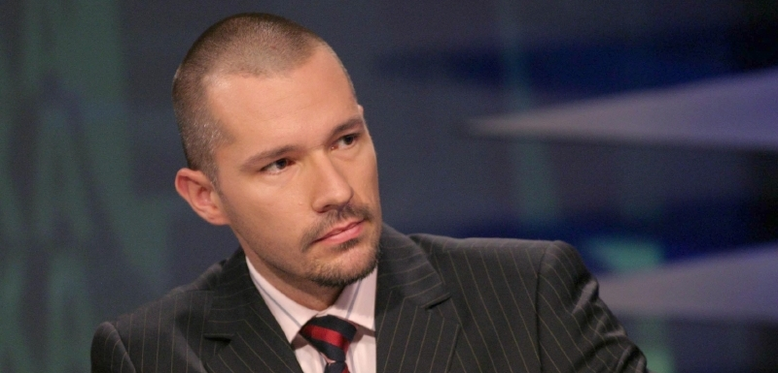

Slide 4

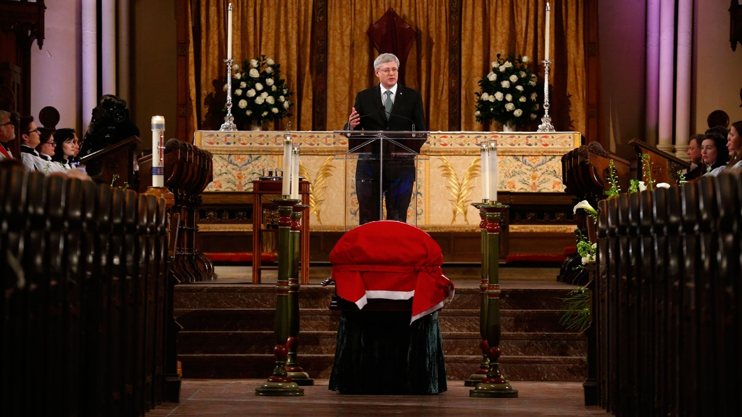

Slide 5

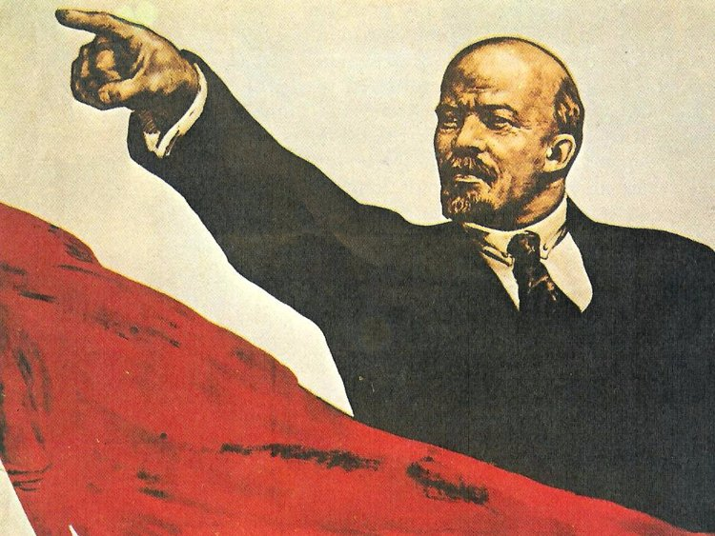

Slide 6
Personal connection to speech
Mom – radio speaker (remember the voice in Brno public transport before 2015 ?)
Father – engineer
Listening to the radio and TV all the time and commenting how people spoke.
Planned to be a professional musician and/or recording engineer
Met speech processing in the 4th year of engineering studies (as you guys …) and stayed with ever since.

Slide 7
Agenda
Emotivní úvod
Basic “management” info
Brno in the neural speech processing history
Současná výzkumná témata
Coming soon …
Jak se zapojit ?

Slide 8
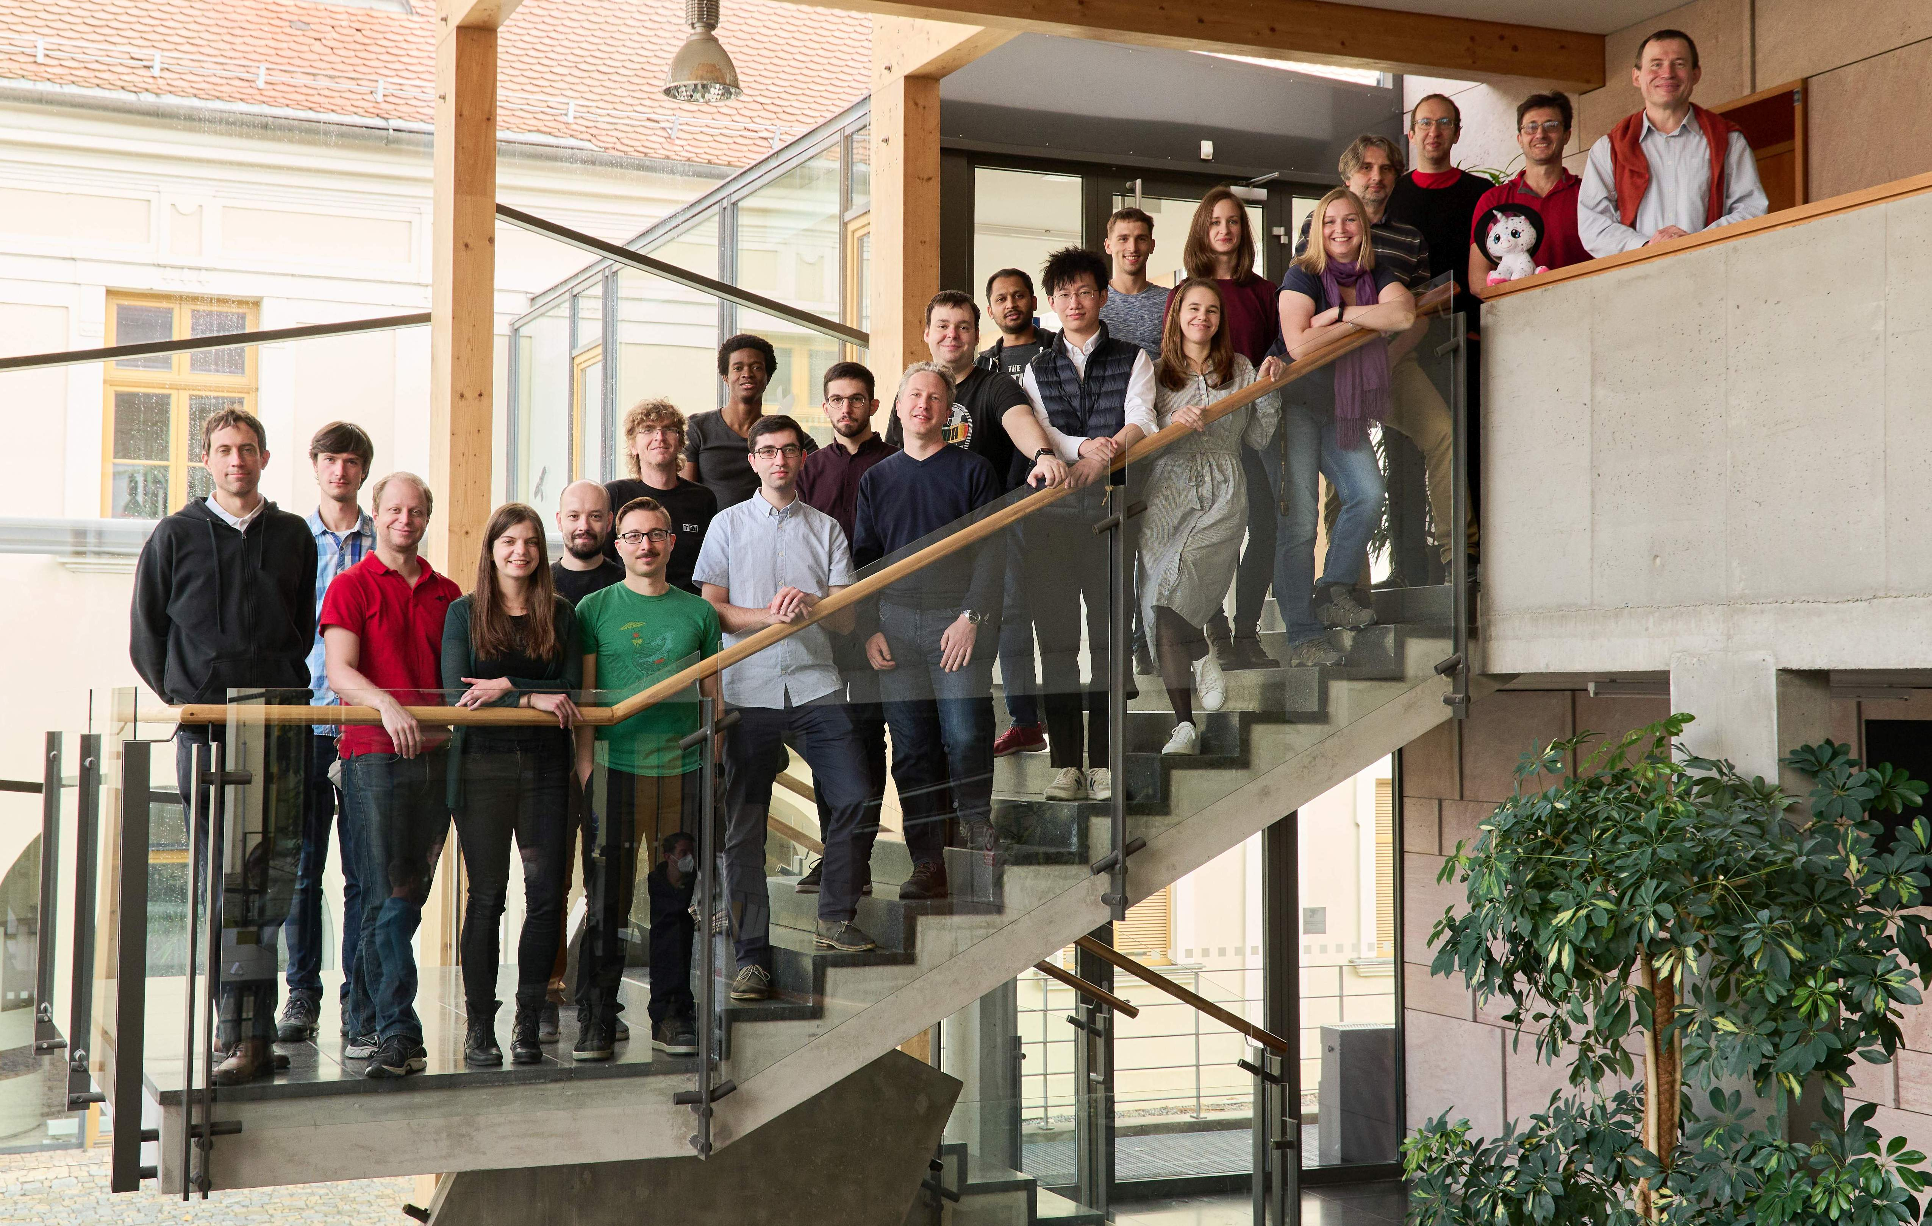









BUT Speech@FIT
(est. 1997)

Slide 9
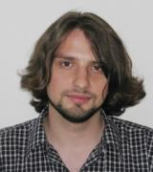
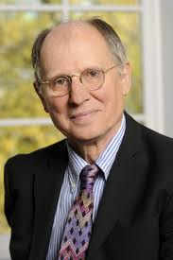
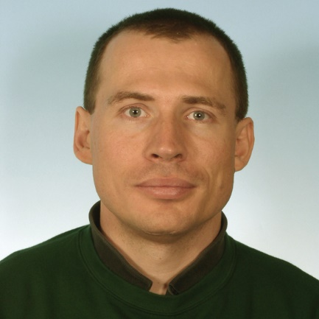
Leaders
Lukáš Burget
Research director and the central brain
Hynek Heřmanský
JHU Emeritus and the psychoacoustic guru (now back in Brno)
Honza Černocký
Managing director

Slide 10
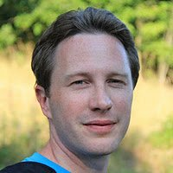
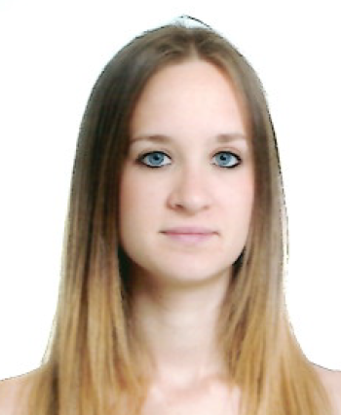
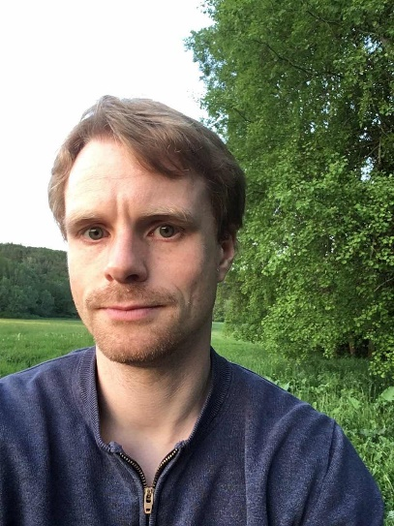
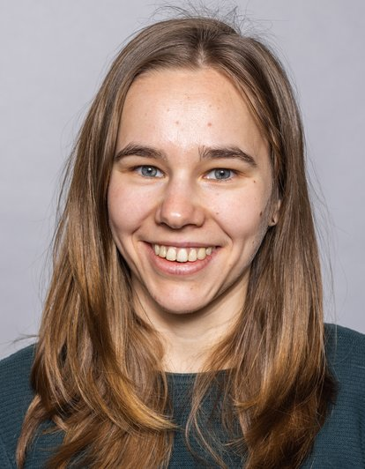
Senior researchers – SID/LID
Oldřich Plchot
Johan Rohdin
Anna Silnova
Mireia Diez Sanchez

Slide 11
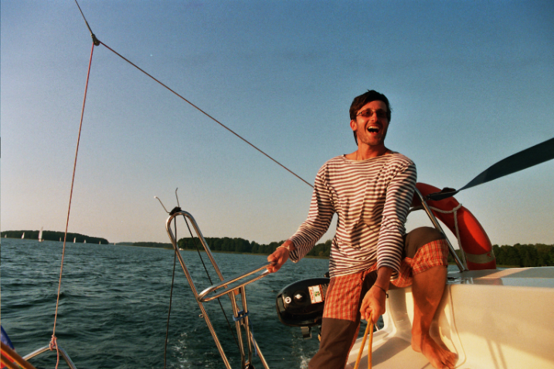
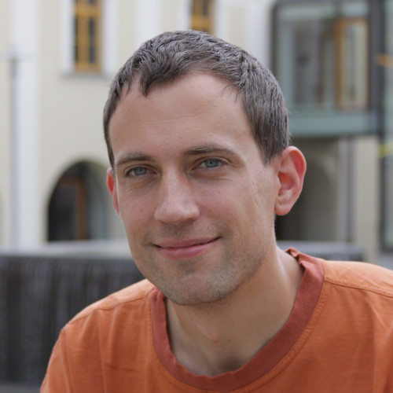
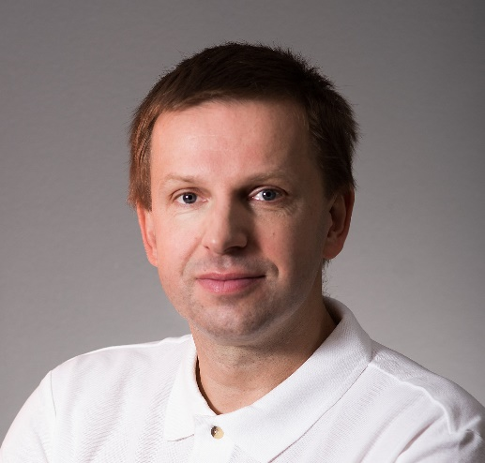
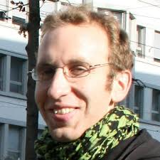
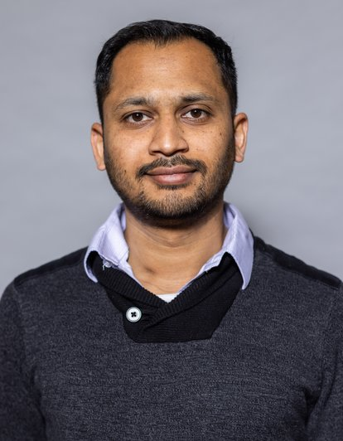
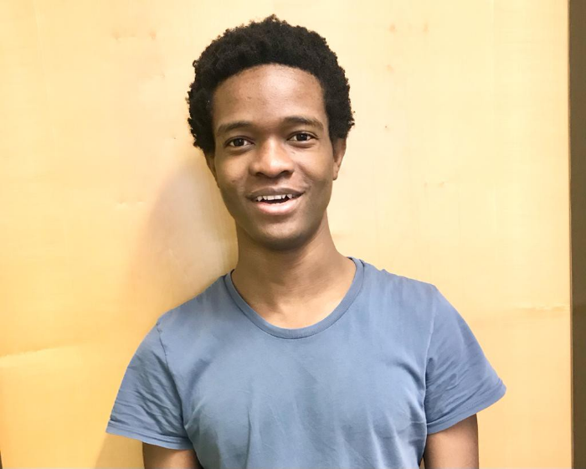
Senior researchers – ASR
Martin Karafiát
Igor Szöke
Petr Schwarz
Karel Veselý
Santosh Kesiraju
Bolaji Yusuf

Slide 12
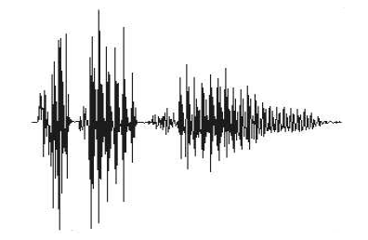
Activity
Speaker/Voice
Recognition
Who speaks?
Links to NLP
Dialog systems
Voice Deepfakes
Voice anonymization
Evaluations of speech and NLP technologies
John Doe
Gender
Recognition
What gender?
Male or Female
Language
Recognition
What language?
English/German/??
Speech
Recognition
“John” spotted
audio (speech)
What was said?
“Hello John!”
Time/relation
analysis
Who asked to whom?
John asked Paul

Slide 13
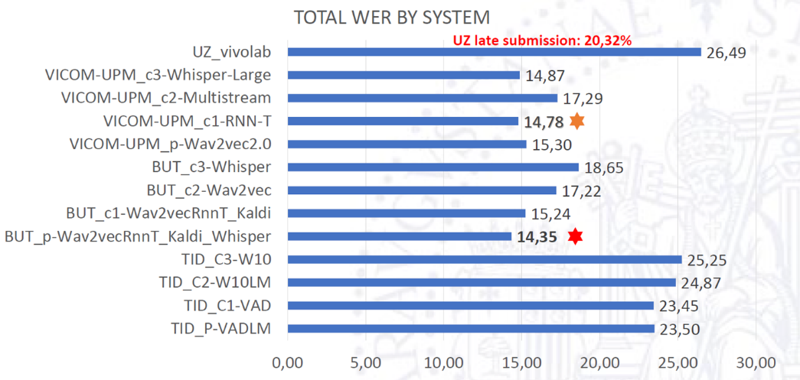
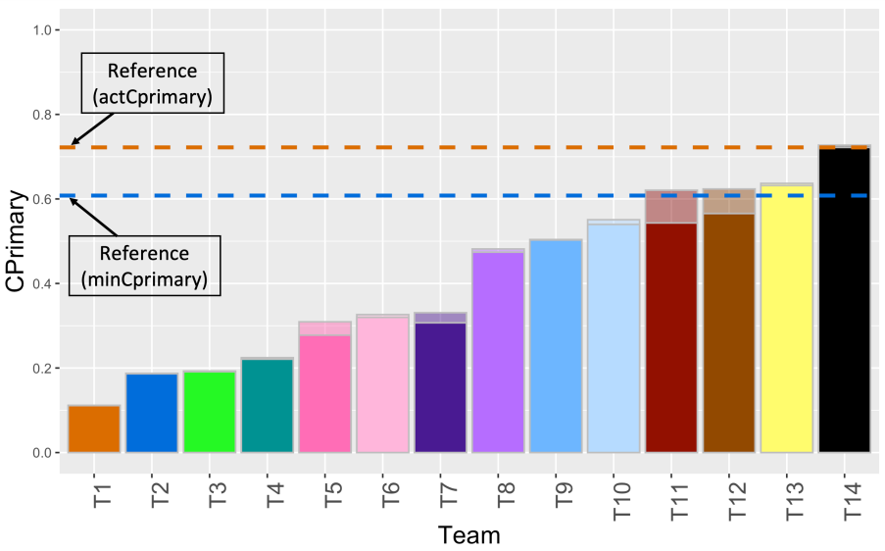
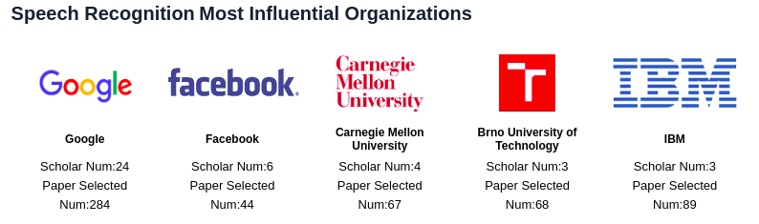
Highlights
Aminer 2021: BUT among 5 most influential organizations in speech recognition.
Research.com: Lukas Burget the 5th most cited Czech computer science researcher
Excellent results in international evaluations (challenges)

Slide 14
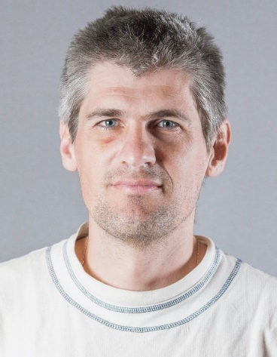
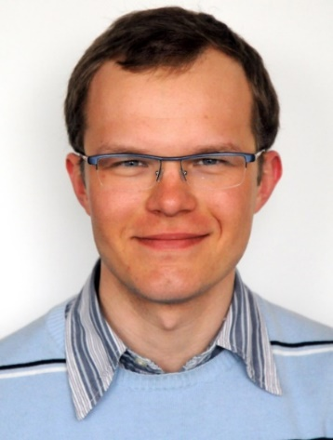
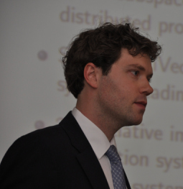
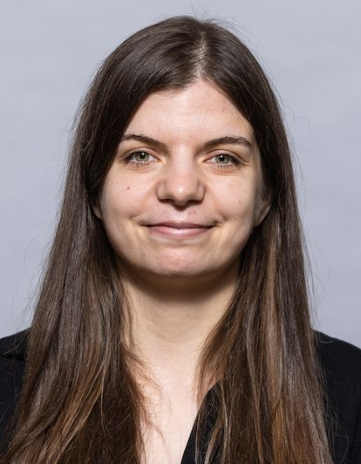
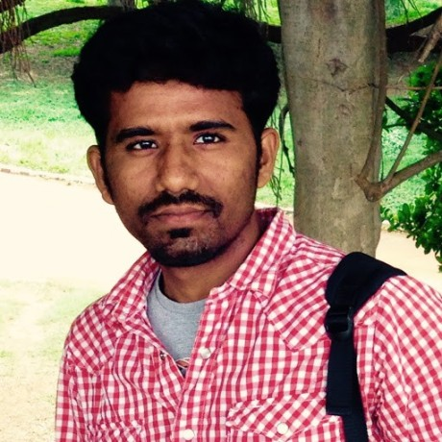
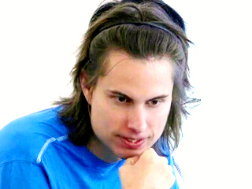
Proud of our alumni !
21“native”, 3 elsewhere (IIIT-H India, NUST Norway, ZCU Pilsen)
  Tomáš Mikolov – founder of NN embeddings, BUT -> Google -> Facebook -> CTU
  (167k citations on Google Scholar)
  Petr Motlíček – speech group leader at IDIAP Switzerland (+ assoc. prof at BUT)
  Ilya Oparin – manager of Language Modeling group at Apple Inc.
  Marcel Kockmann – CTO at Validsoft
  Kateřina Žmolíková – Researcher at Meta London
  Murali Karthick Baskar – Researcher at Google Research, N.Y.

Slide 15
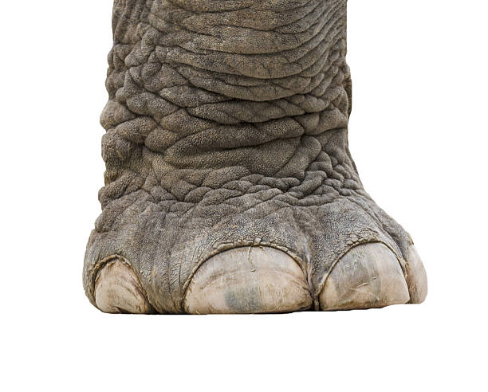












Funding - ~1.5 MEUR / year, 85% competitive
EC projects
US
National
Industry

Slide 16



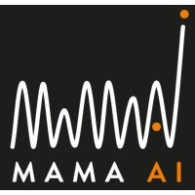






Industrial cooperation

Slide 17


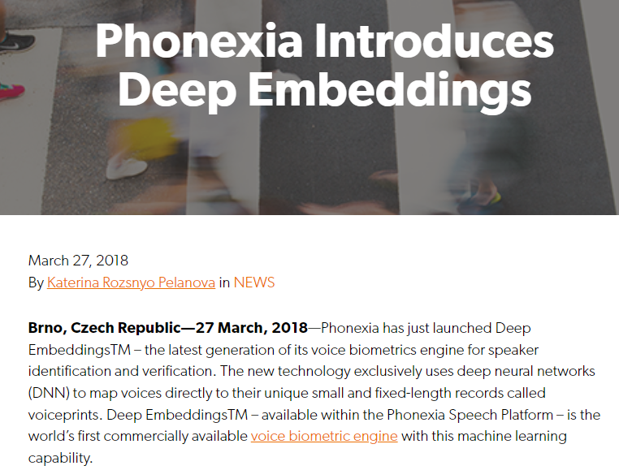
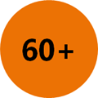
Spin-offs

Slide 18
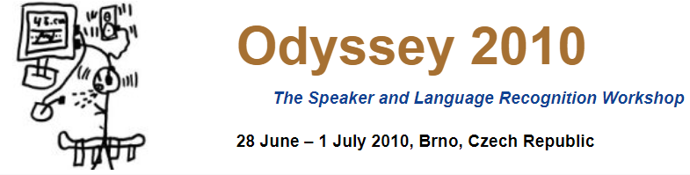
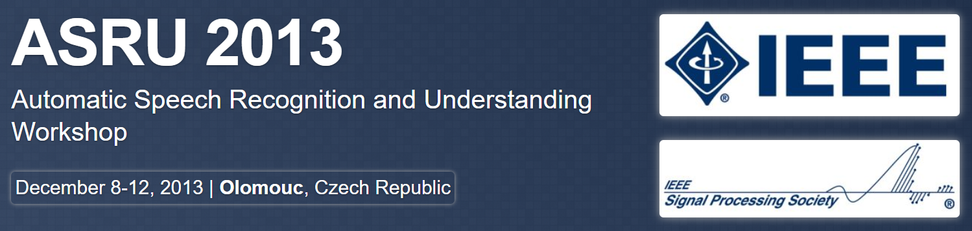
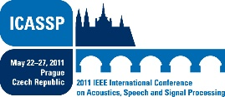
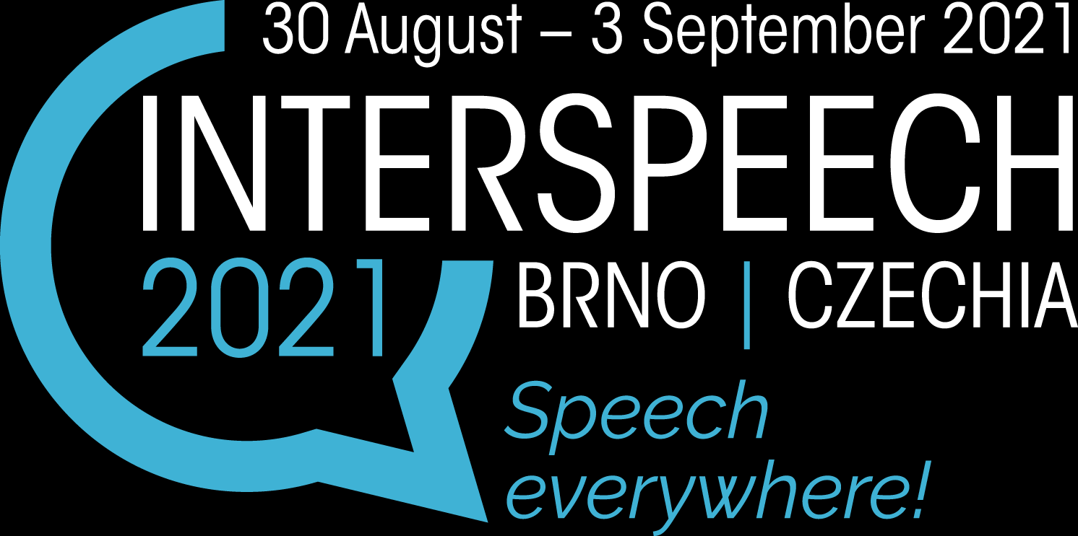
Community service

Slide 19
Agenda
Emotivní úvod
Basic “management” info
Brno in the neural speech processing history
Současná výzkumná témata
Coming soon …
Jak se zapojit ?

Slide 20
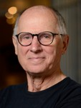
With Hynek around 2001 …
Long temporal trajectories for speech feature extraction
Band classifers and merger were neural networks !
They worked worse than standard MFCC features…
I don’t remember if we called it “AI”, probably not.

Slide 21
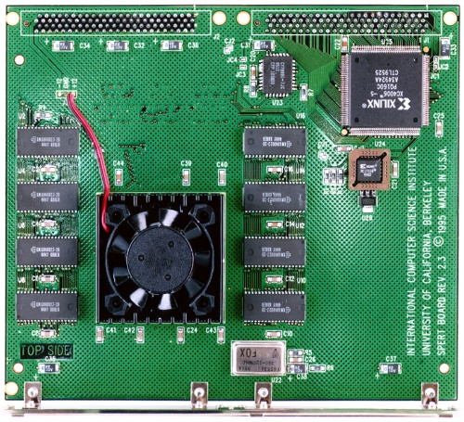
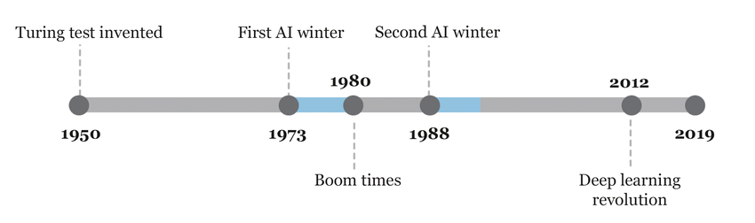
He he he, these guys believe Hynek’s stuff
Around 2000, people simply did not like neural networks.
Working with them involved writing own code, using obscure custom hardware
Data was hard to get
Every community was “hermetic”, people did not talk and did not understand each other …

Slide 22
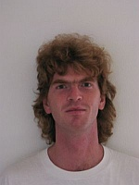
Franta Grezl 2007: NN bottle-neck features first beating MFCCs!
GRÉZL František, KARAFIÁT Martin, KONTÁR Stanislav a ČERNOCKÝ Jan. Probabilistic and bottle-neck features for LVCSR of meetings. In: Proc. IEEE International Conference on Acoustics, Speech and Signal Processing (ICASSP 2007). Hononulu: IEEE Signal Processing Society, 2007, s. 757-760. ISBN 1-4244-0728-1.

Slide 23
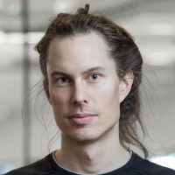
Tom Mikolov 2010: Recurrent Neural networks do work for language modeling
MIKOLOV Tomáš, KARAFIÁT Martin, BURGET Lukáš, ČERNOCKÝ Jan a KHUDANPUR Sanjeev. Recurrent neural network based language model. In: Proceedings of the 11th Annual Conference of the International Speech Communication Association (INTERSPEECH 2010). Makuhari, Chiba: International Speech Communication Association, 2010, s. 1045-1048. ISBN 978-1-61782-123-3. ISSN 1990-9772.

Slide 24
Karel and Martin 2012:
Multi-lingual NN training
Split output layer in language-dependent parts
Train on many languages (tweaking the training criterion)
Define new block for
the new language
Train only this block
Fine-tune the whole net
VESELÝ Karel, KARAFIÁT Martin, GRÉZL František, JANDA Miloš and EGOROVA Ekaterina. The Language-Independent Bottleneck Features. In: Proceedings of IEEE 2012 Workshop on Spoken Language Technology. Miami: IEEE Signal Processing Society, 2012, s. 336-341. ISBN 978-1-4673-5124-9.

Slide 25
Agenda
Emotivní úvod
Basic “management” info
Brno in the neural speech processing history
Současná výzkumná témata
Coming soon …
Jak se zapojit ?

Slide 26
15 years back …
Some data
Lots of math, thinking and programming
The newest very advanced Gaussian model based algorithm
The world’s best results
Some computers

Slide 27
10 years back …
Lots of data
Lots of math, thinking and programming
The newest very advanced NN based algorithm
The world’s best results
Many computers with GPUs

Slide 28
5 years back …
Little in-domain data
Lots of out of domain data
Lots of math, thinking and programming
Even more advanced NN based algorithm
The world’s best results
Even more computers with GPUs

Slide 29
Now
Little in-domain data
Big pre-trained model
The most advanced NN algorithm based on a pre-trained model
The world’s best results
Some math, thinking and programming
Many computers with GPUs

Slide 30
Research in the era of large pre-trained models
Ignore them – NOT OK
Improve them and fine-tune for own tasks – OK
Use them as feature generators – OK
Combine / fuse them with some others schemes – OK
Criticize them (proprietary, energy and data foot-print, etc.) and trying to come up with something light / own / better / license free – OK

Slide 31
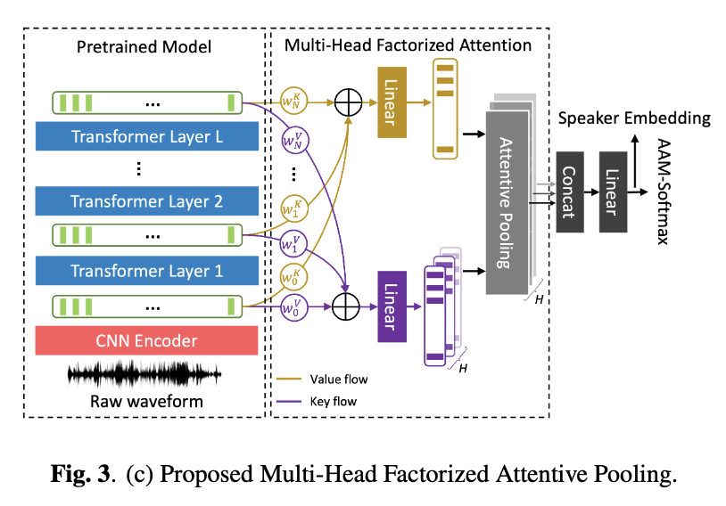
Speaker recognition: Attention-based SV backend on top of WavLM
Exploring fine-tuning strategies for adapting large pre-trained models to speaker verification
Several feature extraction approaches built on top of a pre-trained model,
Multi-head factorized attentive pooling to factorize the comparison of speaker representations into multiple phonetic clusters.
Excellent results on standard speaker verification data-sets (VoxCeleb)
But also “tweaking it” for other tasks – detection of voice deepfakes in the ASVspoof 5 challenge.
Peng, Junyi, et al. "An attention-based backend allowing efficient fine-tuning of transformer models for speaker verification." in Proc. IEEE SLT 2022

Slide 32
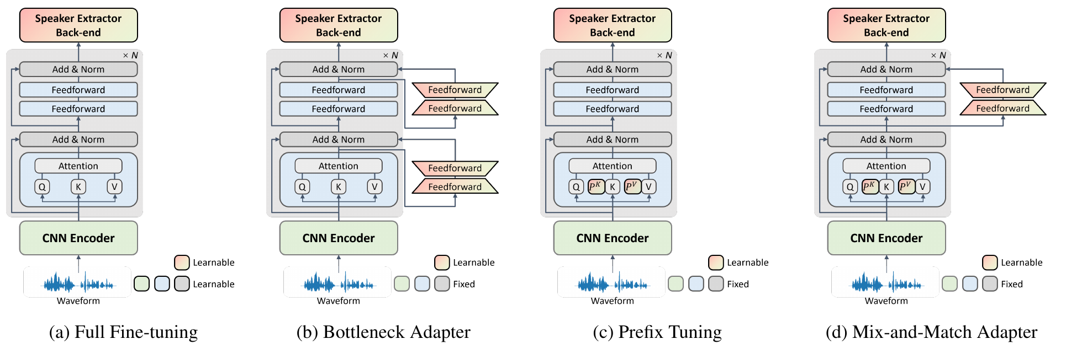
Transformer models and adapters for speaker recognition
Peng, Junyi, et al. "Parameter-efficient transfer learning of pre-trained Transformer models for speaker verification using adapters." IEEE-ICASSP 2023

Slide 33
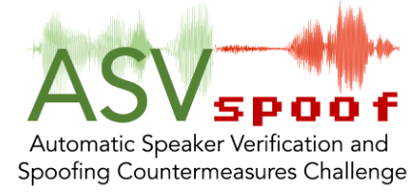
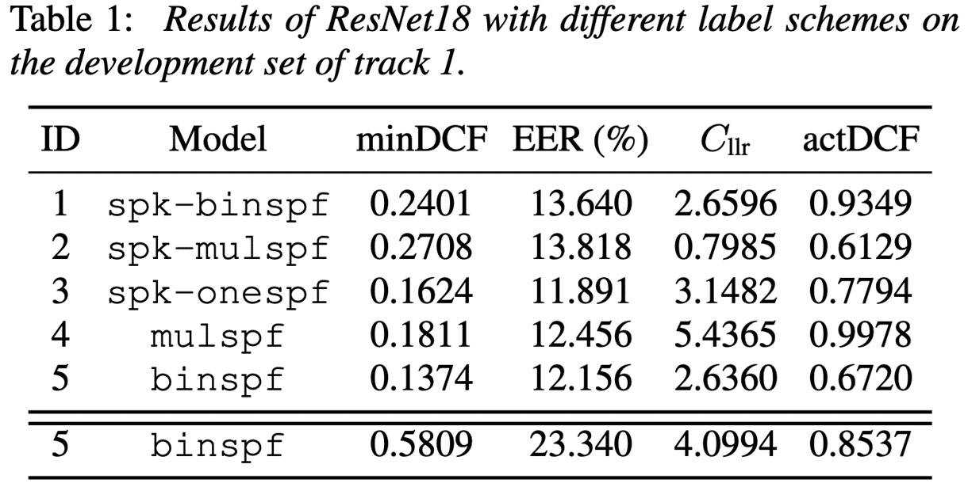
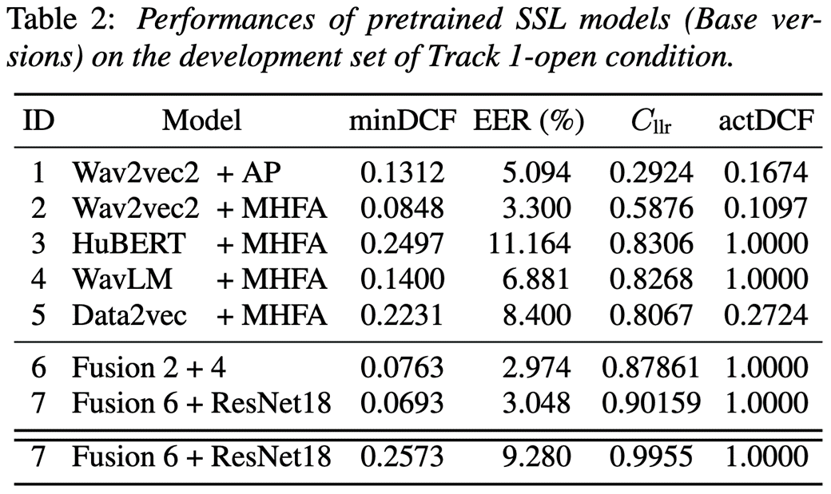

Spoofing detection – AVSpoof 5
Tracks 1: Voice deepfake detection, 2: spoofing-robust automatic speaker verification.
Massive use of Multi-head factorized attentive pooling (MHFA) developed for speaker recognition by Junyi Peng et al. allowing to use large models.
Huge difference in Closed and Open conditions.

Slide 34
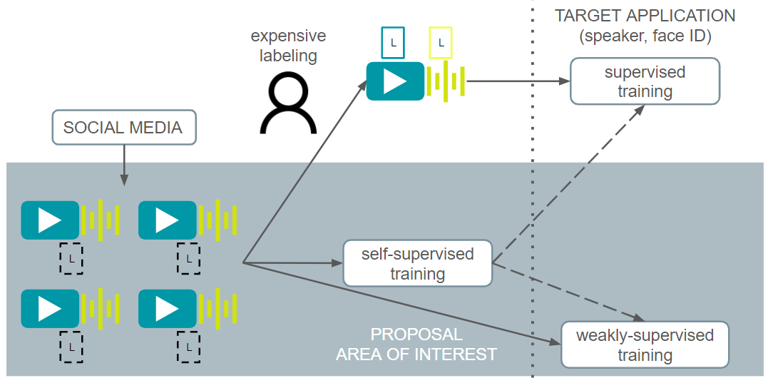
Problem with data for SV training …
multimedia platforms produce masses of data with coarse-grained labels (e.g., identity of one or more persons participating in the recording)

Slide 35
Unstructured or Weakly Labeled Data in SV training
Tencent AI Lab Rhino-Bird project
Two stages
  Detect speech chunks of the target speaker
    Basic speaker diarization algorithm (no pre-trained models used), with assumption: of clusters of high purity, low speaker coverage
    Train a network with an aggregation function over clusters
    Select chunks corresponding to the celebrity of interest
  Supervised training with the selected speech chunks
    Train a new model from scratch using standard supervised training
Tested multiple embedding extraction architectures, clustering techniques, etc.
Results almost on par with using labelled data.
Themos Stafylakis, Ladislav Mošner, Oldřich Plchot, Johan A. Rohdin, Anna Silnova, Lukáš Burget and Jan Černocký“, Training Speaker Embedding Extractors Using Multi-Speaker Audio with Unknown Speaker Boundaries”, In Interspeech, 2022.

Slide 36
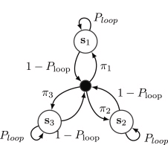
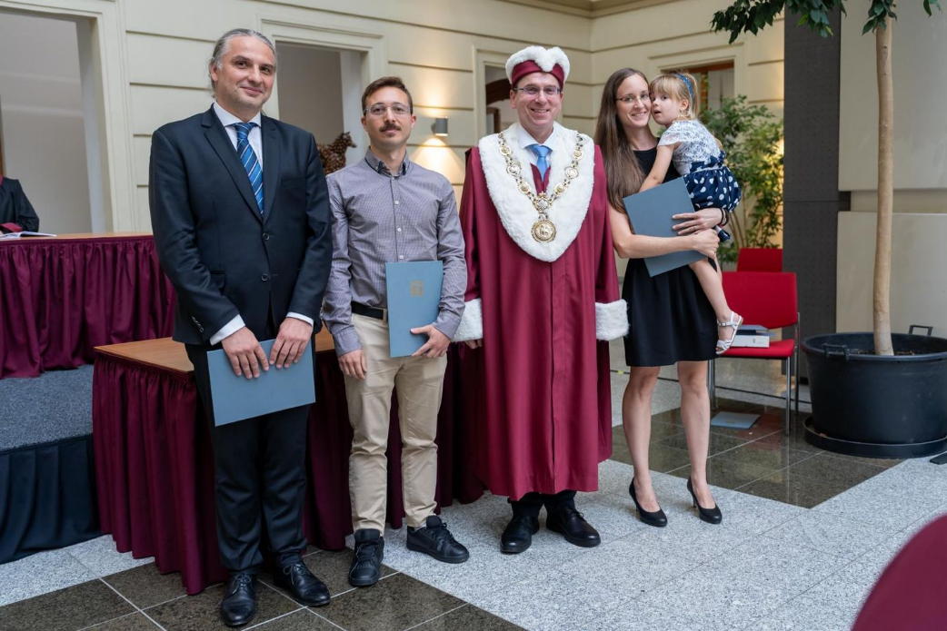
Speaker diarization
Variational Bayes HMM (VBx) approach is a de-facto standard in the community
Received “BUT Rector's Award for a publication with “an exceptionally rapid positive response from the scientific community”
Deployed in commercial diarization
by Phonexia and delivered to the Police
of Czech Republic in MoI sponsored project
Federico LANDINI, Ján PROFANT, et al: Bayesian HMM clustering of x-vector sequences (VBx) in speaker diarization: Theory, implementation and analysis on standard tasks. Computer Speech and Language, vol. 71, no. 101254, 2022, pp. 1-16. ISSN 0885-2308.

Slide 37
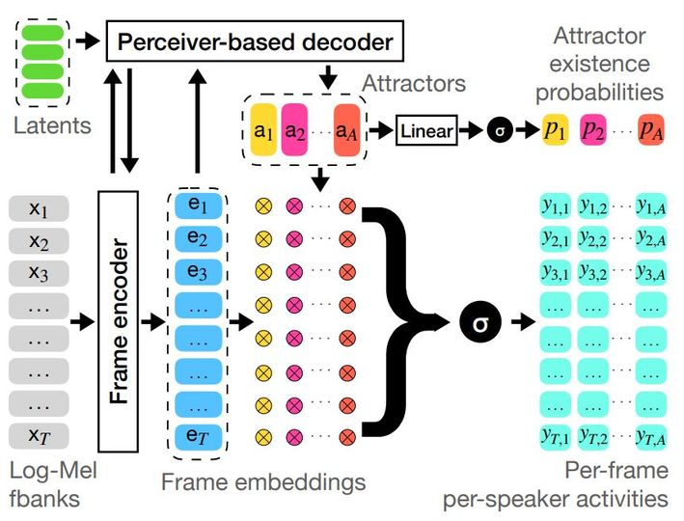
End-to-end diarization - DIAPER
fully-attentive alternative for computing speaker attractors in the context of end-to-end neural diarization.
better performance than encoder-decoder-based attractors (EEND-EDA) with a more light-weight design
finding the number of speakers more accurately and better handling overlapped speech
non-iterative single-stage system.
F. Landini, M. Diez, T. Stafylakis and L. Burget, "DiaPer: End-to-End Neural Diarization With Perceiver-Based Attractors," in IEEE/ACM Transactions on Audio, Speech, and Language Processing, vol. 32, pp. 3450-3465, 2024, doi: 10.1109/TASLP.2024.3422818.

Slide 38
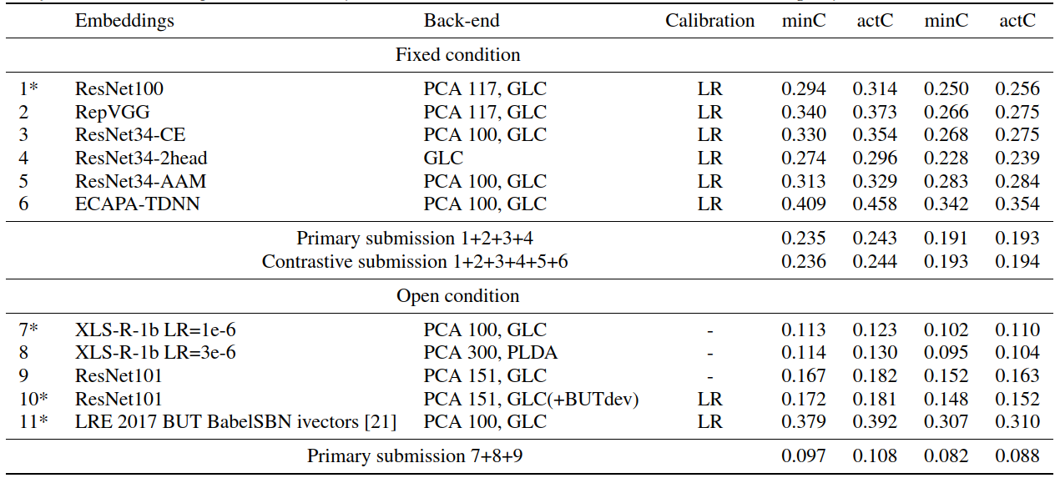
Language identification - NIST 2022 LRE evaluation
Fixed condition - all systems based on ResNet and its variants (adopted from computer vision guys!)
Open condition
- large
pre-trained
wav2vec2
xls-r-1b
BUT,
Phonexia and
Omilia
(Greece)

Slide 39
Results
2nd place in closed
and 3rd in open
condition
The best team
managed to re-train
the big model
SILNOVA Anna, et al: ABC System Description for NIST LRE 2022. In: Proceedings of NIST LRE 2022 Workshop. Washington DC: National Institute of Standards and Technology, 2023, pp. 1-5.

Slide 40
ASR - Albayzin challenge
organized by the Spanish thematic network on speech technologies (RTTH).
transcription of TV shows
massive "ASR hammer"
consisting of:
  XLS-R Conformer
  XLSR CTC
  Whisper + post-processing
  RNN-T
  Hybrid CNN-TDNN-HMM
Cooperation with Telefonica
Barcelona
1st place
Jahnavi Umesh et al: BCN2BRNO: ASR System Fusion for Albayzin 2022 Speech to Text Challenge, in Proc. Iberspeech 2022.

Slide 41
CHiME 8 – NOTSOFAR
Task 2 - Distant Meeting Transcription with a Single Device, 2 tracks
  Single-Channel
  Known-Geometry Multi-Channel
Classical approach
  speaker diarization first
  decoding speech for individual
  speakers based on labels produced
  by the diarization
The goal is to take advantage
of an available large model
- Whisper.

Slide 42


CHiME-8 – joint team of BUT and JHU
Conditions on the entirety of the diarization output
  Encode: Silence (S), Target Speech (T) Non-target Speech (N) Overlapped speech (O)
  Each STNO class is encoded via a frame-level affine transformation at the input of transformer blocks
Additionally fine-tune with CTC to mitigate hallucinations (down-sampled outputs for CTC)
Multi-channel decoding by running single-channel model in parallel (average 8th-layer outputs)
Not the best results but committee’s prize for the most innovative approach !
Alexander Polok, Dominik Klement, Jiangyu Han, Šimon Sedláček, Bolaji Yusuf,
Matthew Maciejewski, Matthew Wiesner, Lukáš Burget: Target Speaker ASR with Whisper, in Proc. CHiME workshop 2024.

Slide 43



ASR in different projects
MoI sponsored research, deliveries and testing
Czech dialects in the JARIN project
  with dialectologists of the Institute of the Czech language and geo-informaticians from University of Palacky Olomouc.
EU CNECT - contract with the EU

Slide 44


Speech dialogs
Explainability and ethics in speech dialog systems
  EU project ELOQUENCE running from 01/2024
  Looking into biases, fact checking, grounding, etc
  Cooperation with partners (Telefonica, IDIAP, Omilia) and NLP group (Martin Fajcik)
  Hopefully not “legal project with a little engineering component”.

Slide 45
Tackling far-field microphones
By NN signal pre-processing with existing speech / speaker recognition
In case of multiple microphones, by neural beam-forming.
By informed selection of target speaker from mixture (SpeakerBeam).
By training the whole architecture as one block in end-to-end fashion.
ŽMOLÍKOVÁ Kateřina, DELCROIX Marc, BURGET Lukáš, NAKATANI Tomohiro and ČERNOCKÝ Jan. Integration of Variational Autoencoder and Spatial Clustering for Adaptive Multi-Channel Neural Speech Separation. In: 2021 IEEE Spoken Language Technology Workshop, SLT 2021 - Proceedings. Shenzhen - virtual : IEEE Signal Processing Society, 2021, pp. 889-896. ISBN 978-1-7281-7066-4.
MOŠNER Ladislav, PLCHOT Oldřich, BURGET Lukáš and ČERNOCKÝ Jan. Multi-Channel Speaker Verification with Conv-Tasnet Based Beamformer. In: Proceedings of ICASSP 2022 - 2022 IEEE International Conference on Acoustics, Speech and Signal Processing (ICASSP). Singapore: IEEE Signal Processing Society, 2022, pp. 7982-7986. ISBN 978-1-6654-0540-9.

Slide 46
Agenda
Emotivní úvod
Basic “management” info
Brno in the neural speech processing history
Současná výzkumná témata
Coming soon …
Jak se zapojit ?

Slide 47


European Defense Fund HLTO
EDF will fund evaluations in DARPA/IARPA style in “Agile and
robust human language technologies for defence”
  Organisation of a technological challenge - HLTO
  Participation to a technological challenge - HLTP
Technologies
  language identification from speech, documents and text;
  speech recognition;
  handwritten and printed document recognition;
  keyword spotting from speech and handwritten or printed documents;
  translation from speech, handwritten or printed documents, and texts;
  high-level semantic (including military-specific) information extraction, such as named entity and event recognition, and relation extraction;
  cross-language information retrieval;
  automatic (multi-)document summarisation and visualisation.
HLTO Team coordinated by Airbus Defence, several EU partners, starting 01/2025.

Slide 48



June – August 2025: JSALT in Brno
Frederick Jelinek Summer Workshop on Speech and Language Technology
32nd edition, cooperation with CLSP of the Johns Hopkins University
Competitive bid for research topics that will form research groups.
6 weeks of research collaboration, pre-pended by a 2-week
summer-school.
Supported by European ESPERANTO project, US,
European and local sponsors.

Slide 49
Agenda
Emotivní úvod
Basic “management” info
Brno in the neural speech processing history
Současná výzkumná témata
Coming soon …
Jak se zapojit ?

Slide 50
Diplomky https://docs.google.com/document/d/1EJNMyun8zoLodlHjGoNeYdG4Cq1VOO5f8zeHZr99J8Y/edit?usp=sharing – bude update, ale dává přehled o tom, co se dělá.
Erasmus/Socrates – pomůžeme Vás vystrčit k šikovným kolegům v EU, ale i v USA nebo Asii – akademické labiny i průmysl
PhD
Doporučení / nedoporučení firem
Start-ups in speech
Pomoc s JSALT workshopem v létě

Slide 51

Thank you for your attention https://speech.fit.vutbr.cz/

